Slide 1
Cancer Classification using improved Extreme Learning Machine
Ankita Shreya
Department of Computer Science | IIIT Bhubaneswar
ankita9shreya@gmail.com
CIBCB 2019, July 9-11, 2019, Siena, Italy | 16th IEEE International Conference on Computational Intelligence in Bioinformatics and Computational Biology

Slide 2
Outline
Introduction
Basic Concepts
Proposed Methodology
Experimental details
Results and Discussion

Slide 3
Introduction
Basic Concepts
Proposed Methodology
Experimental details
Results and Discussion

Slide 4
Cancer Classification
The task of cancer classification is entirely based on efficient analysis of gene expression dataset.
As these gene expression datasets carry huge and complex information, it needs an efficient machine learning technique.
As, Extreme learning Machine(ELM) which is a single layer feedforward network(SLFN) has shown remarkable contributions so this has been chosen as the base network architecture.
An attempt has been made to improvise the existing model architecture.

Slide 5
ELM and the existing techniques:
The traditional ELM has two learnable parameters which involves the weights from input layer to hidden layer and the biases.
Initial scenarios involved random initialization of the network parameters.
Evolutionary optimization techniques such as genetic algorithm have also been used.
The major drawback of these algorithms are that they focus on global optimization of the search space, i.e they never look for fine tuning of the structures which are close to the optimal solution.

Slide 6
ELM and the existing techniques:
Apart from this these models have too many controlling parameters-
crossover rate, mutation rate etc.
The efficiency of these models are heavily dependent on the values of the controlling parameters.
So, in this paper we have used jaya optimization algorithm which have only two common parameters- population size and number of generations.
Hence, the jaya optimization algorithm is used for global search.

Slide 7
Contributions of the proposed method
For further fine tuning the structure, i.e for local search space exploration adaptive simulated annealing(SA) is used.
The contribution involves:
A proposed methodology to explore the global as well as local search space in order to get the optimum solution.
To prevent premature convergence of SA , adaptive SA is introduced.
The robustness of the proposed method is verified by testing it against other techniques.

Slide 8
Introduction
Basic Concepts
Proposed Methodology
Experimental details
Results and Discussion

Slide 9
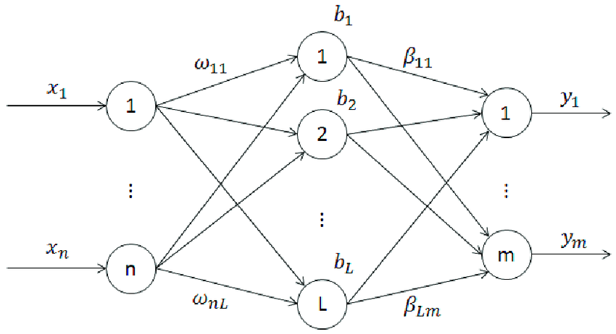
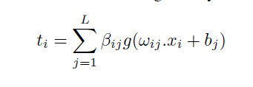
Extreme Learning Machine(ELM)
A three layered structured network; having a base architecture of single layer feed forward neural network
Considering that the chosen activation function are infinitely differentiable
Moore Penrose generalized inverse is used for calculating weights from hidden layer to output layer
Equation used for ELM,

Slide 10

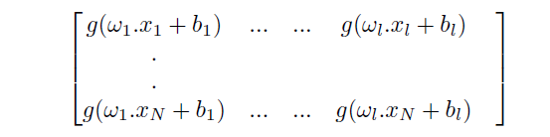

Equations in ELM
The ELM, equation can be represented as, for the purpose of simplicity.
Where H is denoted as,
The weights from hidden layer to output layer, ß is calculated by Moore Penrose generalized inverse as,
The task is to optimize the weights from input layer to hidden layer, ω.

Slide 11
Jaya optimization algorithm
Primary objective of jaya:
A solution should move towards its best and move away from the worst.
Considering there is an objective function to be optimized, ‘n’ number of candidate solution in each generation.
Depending on the fitness value the worst and best candidates for a particular generation are chosen.
The equation for upgrading the existing solution is,

Slide 12
Simulated Annealing(SA)
A local search algorithm simulating the melting and cooling in a metal processing.
Has a variable initial temperature which is set very high and gradual with time cools down.
On improvement front, adjustment to low vitality bond at warming stages is analogous to optimization of fitness function.
Meanwhile, the algorithm seeks the neighbors of the present solution for a superior arrangement.

Slide 13
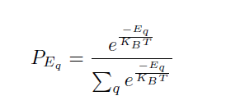
How is it different from Jaya optimization algorithm?
SA have only one solution’s candidate and will be looking for its neighbors to achieve an optimum solution.
How long the SA will be searching for optimum solution?
Depends on the temperature.
This initial temperature will be gradually down over time.
After the final temperature bound is being reached, the process will be stopped.
The Boltzmann probability distribution for energy
state q is,

Slide 14


If system is at time t is in state q, then at t+1, a new state r which is generated and whose probability is given as,
Obtaining a new state r can be obtained as,
The acceptance of new state r is only possible when either one of the following happens:
that is state r is accepted.
then the acceptance probability of state r, should be greater than the random value between 0 and 1.

Slide 15

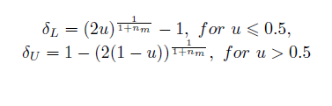
Adaptive Simulated Annealing
While exploring the search space, the fitness value for best solution stagnated for successive generation.
This might had happened because the algorithm might have stuck in local optima and some change in search strategy is needed.
Hence adaptive techniques are used, which involves changing the computation function of state r.

Slide 16
Introduction
Basic Concepts
Proposed Methodology
Experimental details
Results and Discussion

Slide 17
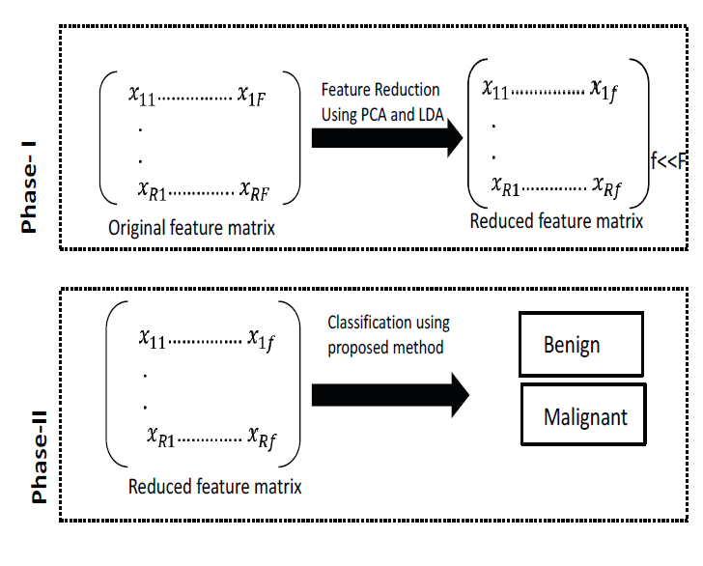
Phase I- Extracting relevant features
As micro-array dataset have highly irrelevant features. So,

Slide 18
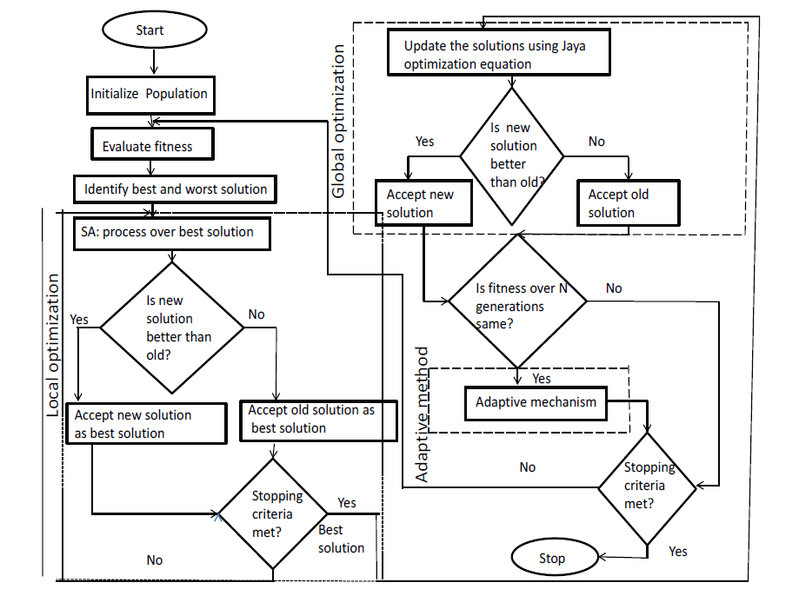
Phase II- Proposed Methodology

Slide 19
Introduction
Basic Concepts
Proposed Methodology
Experimental details
Results and Discussion

Slide 20
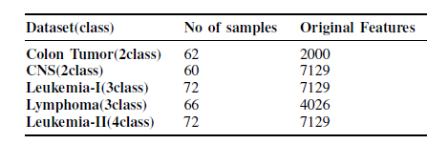
Dataset Description
The following datasets were used for testing purpose:
Each of the dataset were divided into 60:40, training and testing ratio.

Slide 21




Performance metrics
Accuracy
Precision
Recall
F-Score

Slide 22
Introduction
Basic Concepts
Proposed Methodology
Experimental details
Results and Discussion

Slide 23
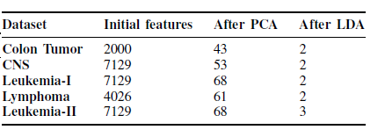
Results and Discussion
Dataset distribution after dimensionality reduction

Slide 24
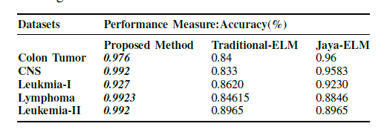
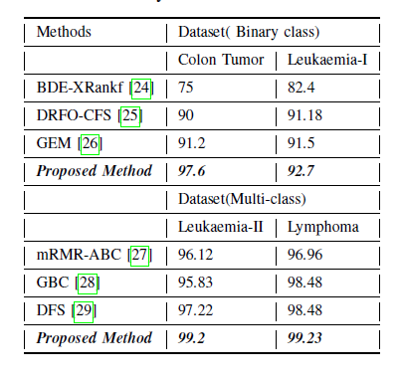
Comparison with the existing techniques

Slide 25
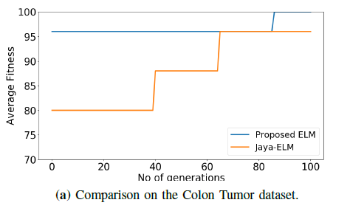
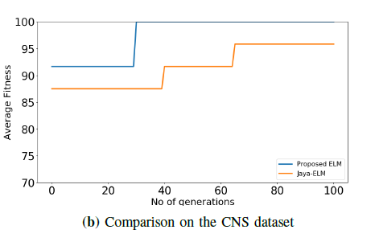
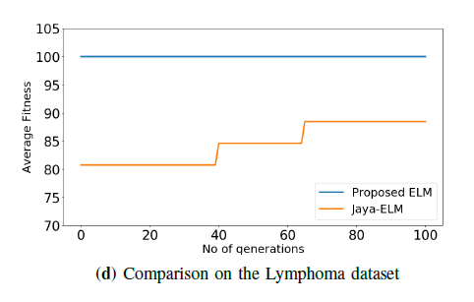
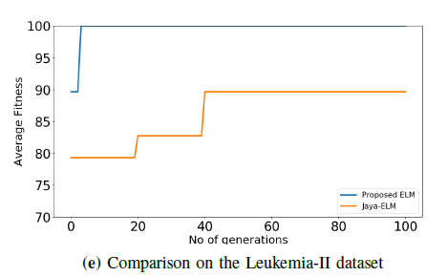
Graph results

Slide 26
References
Cao, Feilong, Bo Liu, and Dong Sun Park. "Image classification based on effective extreme learning machine." Neurocomputing 102 (2013): 90-97.
Ghimire, Sujan, et al. "Self-adaptive differential evolutionary extreme learning machines for long-term solar radiation prediction with remotely-sensed MODIS satellite and Reanalysis atmospheric products in solar-rich cities." Remote Sensing of Environment 212 (2018): 176-198.
Rao, R. "Jaya: A simple and new optimization algorithm for solving constrained and unconstrained optimization problems." International Journal of Industrial Engineering Computations 7.1 (2016): 19-34.
Rao, R. Venkata, and Ankit Saroj. "A self-adaptive multi-population based Jaya algorithm for engineering optimization." Swarm and Evolutionary computation 37 (2017): 1-26.
Van Laarhoven, Peter JM, and Emile HL Aarts. "Simulated annealing." Simulated annealing: Theory and applications. Springer, Dordrecht, 1987. 7-15.
Deb, Kalyanmoy, and Debayan Deb. "Analysing mutation schemes for real-parameter genetic algorithms." International Journal of Artificial Intelligence and Soft Computing 4.1 (2014): 1-28.
Wold, Svante, Kim Esbensen, and Paul Geladi. "Principal component analysis." Chemometrics and intelligent laboratory systems 2.1-3 (1987): 37-52.
Hernandez, Jose Crispin Hernandez, Béatrice Duval, and Jin-Kao Hao. "A genetic embedded approach for gene selection and classification of microarray data." European Conference on Evolutionary Computation, Machine Learning and Data Mining in Bioinformatics. Springer, Berlin, Heidelberg, 2007.
Li, Ke, et al. "Evolving extreme learning machine paradigm with adaptive operator selection and parameter control." International Journal of Uncertainty, Fuzziness and Knowledge-Based Systems 21.supp02 (2013): 143-154.
Zhu, Qin-Yu, et al. "Evolutionary extreme learning machine." Pattern recognition 38.10 (2005): 1759-1763.

Slide 27
Thank You

